Slide 1

Techie Pi
ARUNAI ENGINNERING COLLEGE
Problem Statement:
One-tap SOS that shares location and alerts emergency contacts.

Slide 2
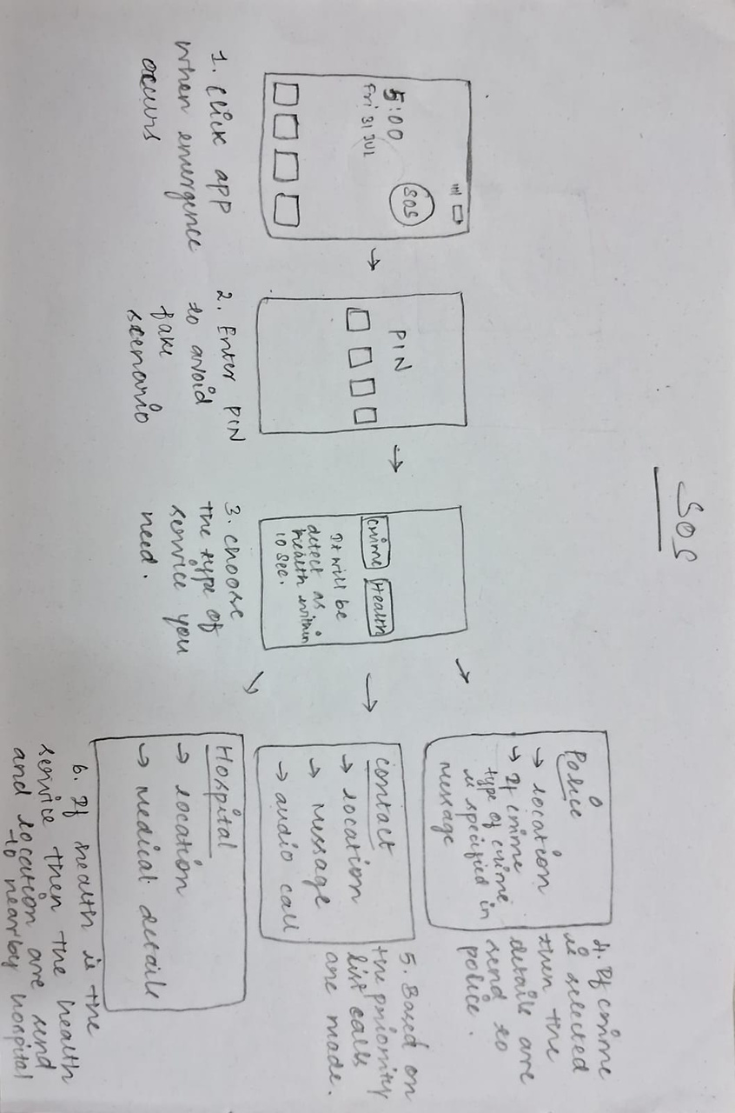
WorkFlow
STEP 1: Open App
STEP 2: Authenticate using 4-digit Panic PIN
STEP 3: Press Big SOS Button
STEP 4: Emergency Alert Triggered
STEP 5: Three Simultaneous Responses
POLICE RECEIVE
AMBULANCE RECEIVE
FAMILY RECEIVE
STEP 6: Confirmation & Tracking

Slide 3
Abstract
Emergency SOS App is an emergency Mobile app that enables immediate emergency response with a tap, using biometric or PIN-based security for avoiding fake triggers. Upon activation, it alerts the police and ambulance services within a 1 km radius, provides medical information about the user to the emergency response team immediately, notifies the family emergency contacts, and uses voice calls to state the name and precise location of the user to the police or ambulance. This application does not involve any decision-making process upon its activation, since one tap is sufficient for multiple channel responses.

Slide 4
Purpose
• Enable Communication during Emergency
• Gives Medical Information to First Responders
• Alerts All Emergency contacts at once
• Immediately Alerts Family
• One Click Means Everything Done

Slide 5


